Slide 1

Chapter 2: Instruction Sets
Embedded System Design

Slide 2
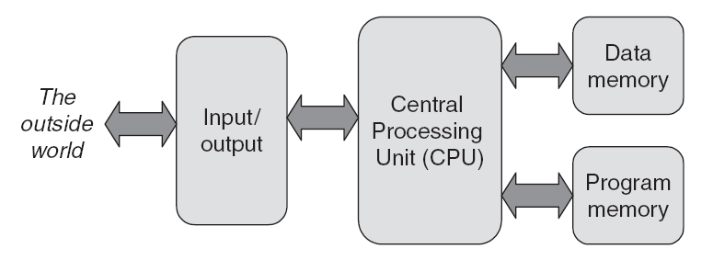
Computer Essentials
Dr. Gheith Abandah
2

Slide 3
Computer Essentials
Instruction Sets
CISC: Complex Instruction Set Computer
RISC: Reduced Instruction Set Computer
Memory Types
Volatile: Random Access Memory (RAM)
Non-volatile: Read Only Memory (ROM)
Dr. Gheith Abandah
3

Slide 4
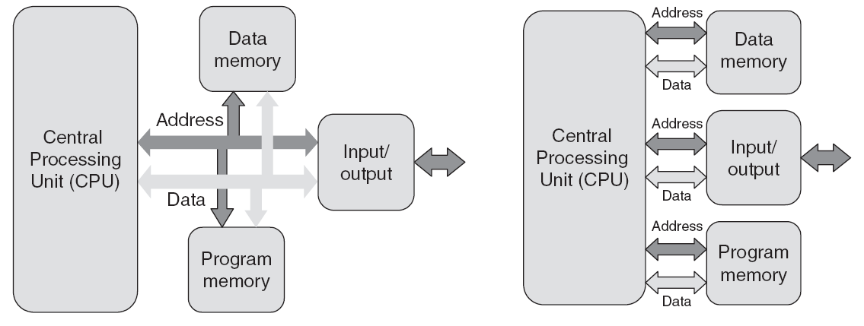
Von Neumann and Harvard Computers
Dr. Gheith Abandah
4

Slide 5
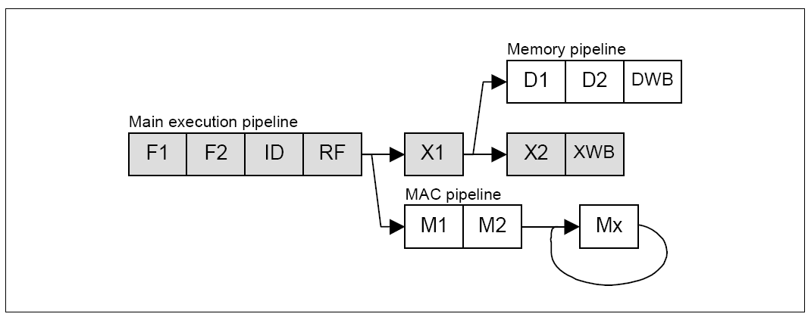
Intel® Super-pipelined RISC Technology

Slide 6
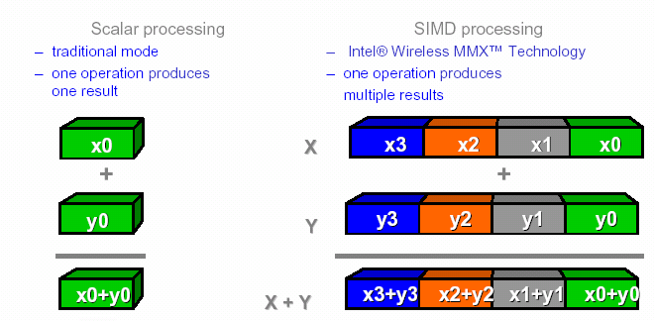
Intel MMX:SIMD

Slide 7
Microprocessors and Microcontrollers
The microprocessor is a processor on one silicon chip.
The microcontrollers are used in embedded computing.
The microcontroller is a microprocessor with added circuitry.
Dr. Gheith Abandah
7

Slide 8
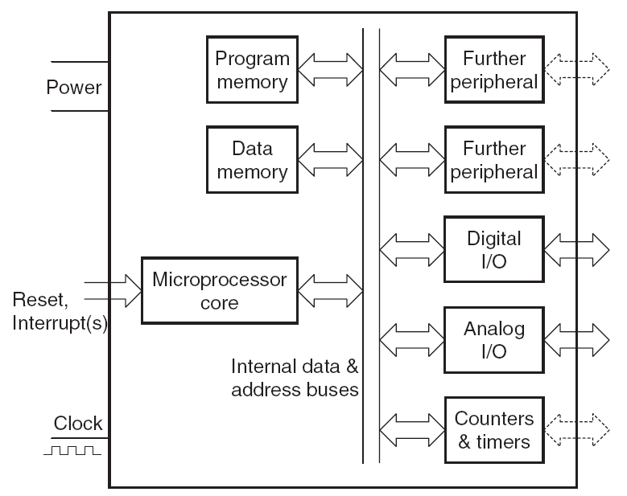
Microcontrollers
Dr. Gheith Abandah
8

Slide 9
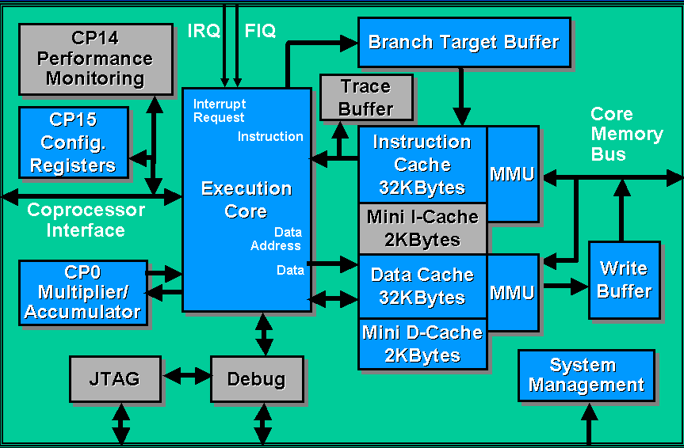
XScale系统结构图

Slide 10

PXA255 Block Diagram
32KHz
3.68MHz
RTC
Osc.
Clock
Dividers
PLLs
Power
Manager
Intel®
XScaleTM
Core
to 400MHz
JTAG
Test &
Debugging
Clock
Controller
Real Time Clock
Timer/PWM
Interrupt
Controller
SDRAM
Control
AC97 Interface
I²S
Address &
16/32 Data Mux
I²C
16 Channel
DMA
Controller
Secondary GPIO
SRAM
Control
IrDA/UART
Bridge
SSP/SPI/uWire
Burst Flash
Interface
MMC
Internal Bus
UART (full modem)
Variable
latency I/O
UART
PCMCIA/CF
Card Control
USB Client v1.1
Color LCD
Controller
Flow-thru DMA
BusReq/Grant
Primary GPIOs

Slide 11
ARM Families
Architecture
ARM v4T
ARM v5TE
ARM v6
ARM Cortex (v7)
Processor Family
ARM7
ARM9
ARM10
ARM11
ARM Cortex

Slide 12

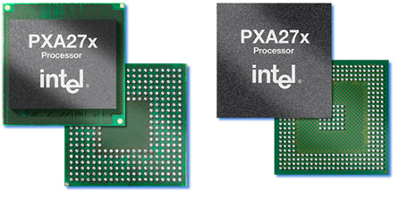
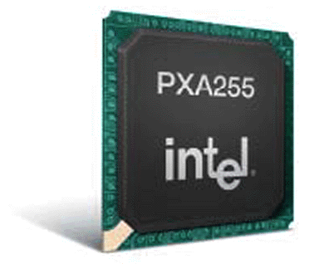
ARM
ARM7
ARM9
ARM9E
ARM10
ARM11
SecurCore
Cortex
Xscale

Slide 13
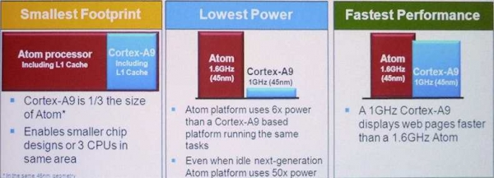
ARM vs. Intel

Slide 14
ARM CPSR
N
z
c
v
I
F
M4
M3
M2
M1
M0
处理器工作模式
负数标志
零标志
进位标志
溢出标志
快速中断请求禁 用
中断请求禁 用

Slide 15
ARM SETS
ADDEQS R0,R1,R2
31～28
27～25
24～21
20
19～16
15～12
11~0
cond
opcode
S
Rn
Rd
op2
0000
001
0100
1
0001
0000
000000000010

Slide 16
ARM SetS
ADDEQS R1,R2,#5
<opcode>{<cond>} {S} <Rd>,<Rn>,<op2>
决定指令执行的条件域
决定指令执行是否影响
CPSR寄存器的值
第一个操作数，为寄存器
操作码
目的寄存器
第二个操作数

Slide 17
ADD
ADD (Addition)
ADD{<cond>}{S} <Rd>,<Rn>,<op2>;
Rd = Rn + op2
ADD R0, R1, R2 ; R0 = R1 + R2
ADD R0, R1, #256 ; R0 = R1 + 256
ADD R0, R2, R3,LSL#1 ; R0 = R2 + (R3 << 1)
17

Slide 18
PIC Microcontrollers
Peripheral Interface Controller (PIC) was originally designed by General Instruments
In the late 1970s, GI introduced PIC® 1650 and 1655 – RISC with 30 instructions.
PIC was sold to Microchip
Features: low-cost, self-contained, 8-bit, Harvard structure, pipelined, RISC, single accumulator, with fixed reset and interrupt vectors.
18

Slide 19
PIC Families
PIC Family | Stack Size | Instruction Word Size | No of Instructions | Interrupt Vectors
12CX/12FX | 2 | 12- or 14-bit | 33 | None
16C5X/16F5X | 2 | 12-bit | 33 | None
16CX/16FX | 8 | 14-bit | 35 | 1
17CX | 16 | 16-bit | 58 | 4
18CX/18FX | 32 | 16-bit | 75 | 2
‘C’ implies CMOS technology; Complementary Metal Oxide Semiconductor
‘F’ insert indicates incorporation of Flash memory technology
Example: 16C84 was the first of its kind. It was later reissued as the 16F84, incorporating Flash memory technology. It was then reissued as 16F84A.
19

Slide 20
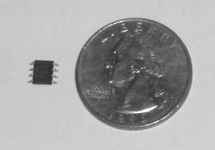
12 Series PIC
The small 12F508
20

Slide 21
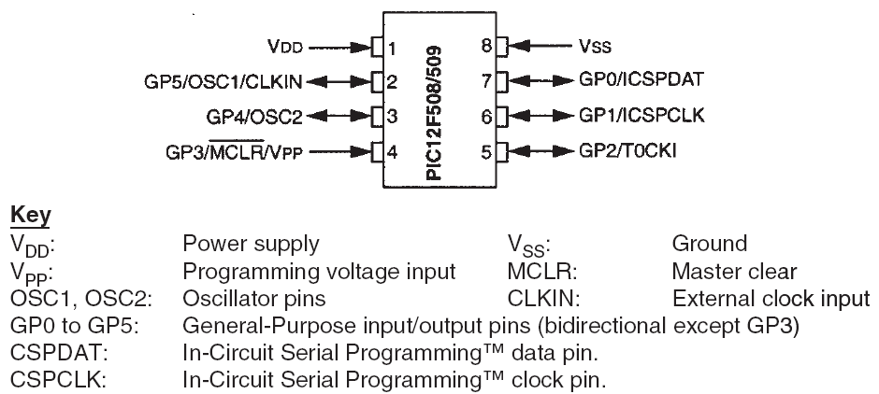
PIC 12F508/509 pin connection diagram
21

Slide 22
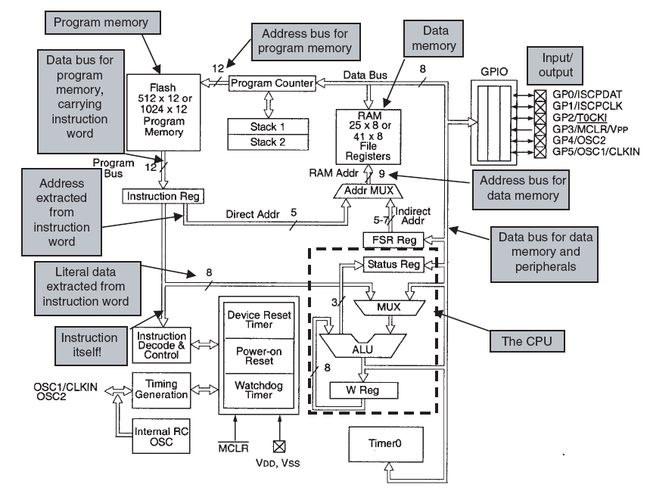
The 12F508 Architecture
22

